Slide 1
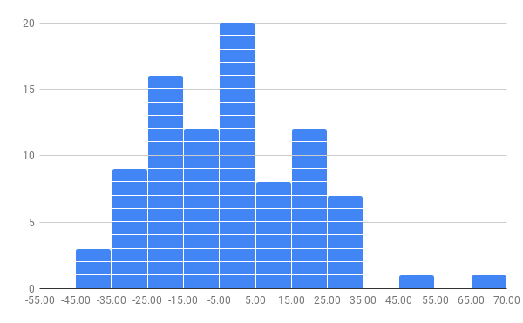
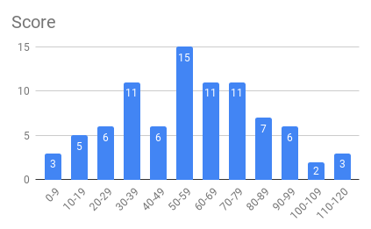

2nd Midterm
兩次期中考分數增減統計
期中考成績分布
各組平均
Average : 58
Highest score : 120

Slide 2
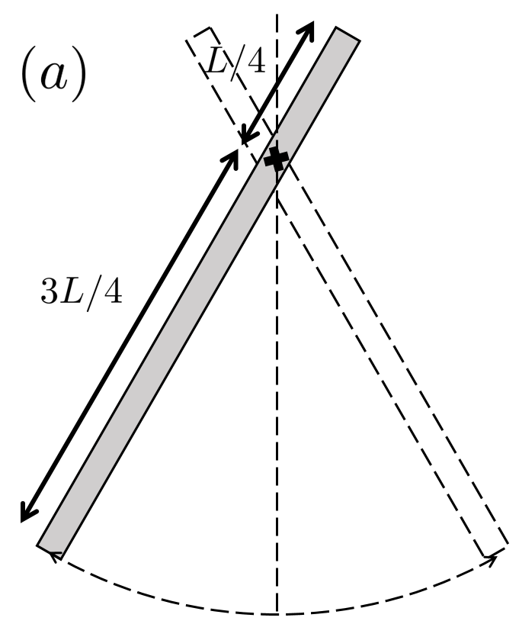






2nd Midterm
Q1. (a) A uniform rod of mass M and length L is rotated around an axis that is going through a point L/4 away from its end, see figure below. If the initial releasing angle is small, what would be the angular frequency of the swinging rod?
(10 pts)
(5 pts)
(5 pts)

Slide 3



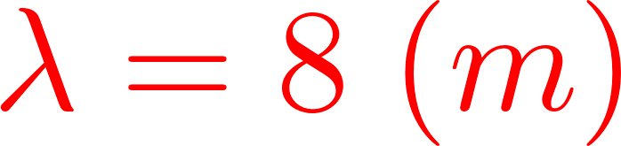












2nd Midterm
Q1. (b) A travelling harmonic wave is travelling in the -x direction, and a snapshot of the wave taken at t = 0 is shown below. Given that the tension is 2 N and the linear mass density of the string is 0.5 kg/m, (1) write down the complete travelling wave expression y(x, t).
(2) What is the velocity of the particle of the string at x = 0 at this instant?
(1)
(3 pts)
(3 pts)
(4 pts)
(2)
At ,
(3 pts)
(7 pts)

Slide 4
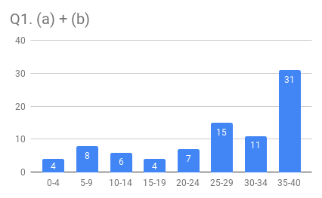
2nd Midterm

Slide 5
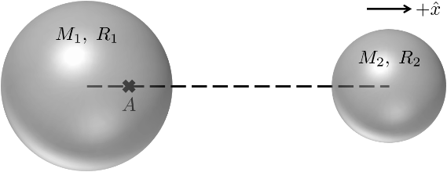






2nd Midterm
Q1. (c) Point A sits inside a shell of mass M₁ and radius R₁, while another massive shell of mass M₂ and radius R₂ is close by, see figure below. Point A is located on the joining line of centers of two shells. And it is at R₁/2 away from the center of shell 1, and 4R₂ away from the center of shell 2. Find the gravitational field strength at point A (it is a vector).
(10 pts)
Q1. (d) Find the steady state solution of the following differential equation
Assume the solution has the following form,
(8 pts)
(2 pts)

Slide 6
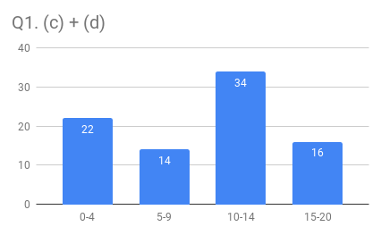
2nd Midterm

Slide 7










2nd Midterm
Q2. The string wave equation is . Assume that an arbitrary shape of wave y(x, t) travels in the +x-direction, answer the following questions,
(a) Use an arbitrary shape of wave to determine the string wave velocity.
(5 pts)
No credit points if you use a sinusoidal traveling wave to prove it.

Slide 8




2nd Midterm
Q2. The string wave equation is . Assume that an arbitrary shape of wave y(x, t) travels in the +x-direction, answer the following questions,
(b) At a fixed position x, are the kinetic energy density (dK/dx) and the potential energy density (dU/dx) the same for an arbitrary shape of string wave? Show your proof.
(2 pts)
(3 pts)
(2 pts)
(3 pts)
No credit points if you use a sinusoidal traveling wave to prove it.

Slide 9
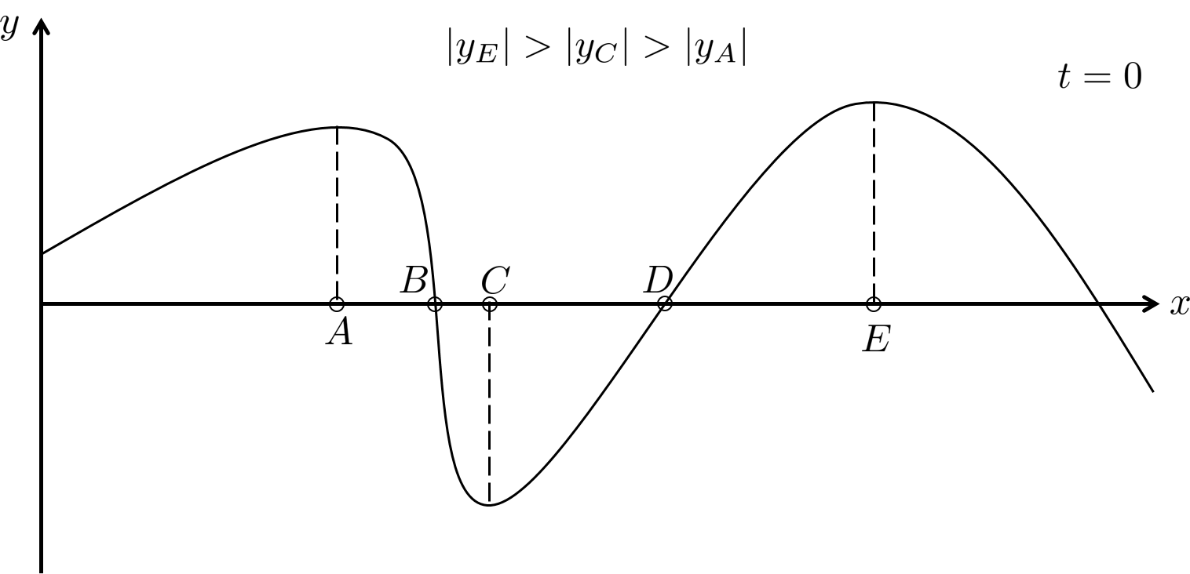

2nd Midterm
Q2. The string wave equation is . Assume that an arbitrary shape of wave y(x, t) travels in the +x-direction, answer the following questions,
(c) A snapshot of the string wave is taken at t = 0. Which segment of the string marked in the following figure possesses the largest energy density? Explain.
Must give your explanation in order to receive credits.
Point B, since it has the largest slope.
(5 pts)

Slide 10
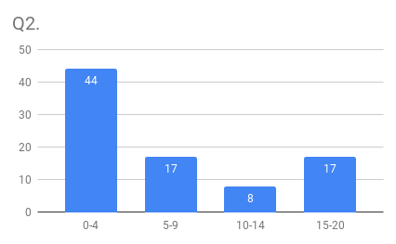
2nd Midterm

Slide 11






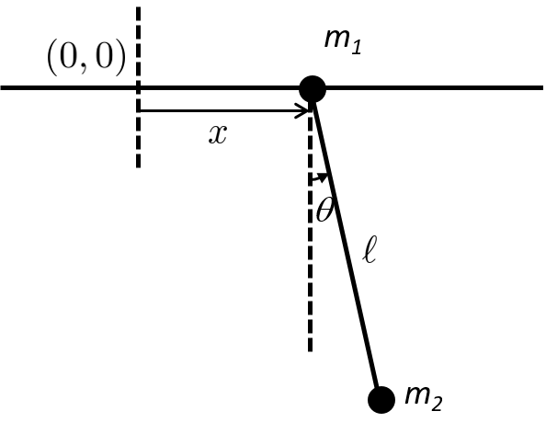







2nd Midterm
Q3. A simple pendulum of mass m₂, with a mass m₁ at the point of support which can only move horizontally on a frictionless track lying in the plane in which m₂ moves as shown in the figure below. The system is placed in a uniform gravitational field . The length of the rod is and its mass is negligible. The angle DOES NOT have to be small.
(a) Let's take an inertial frame whose origin is indicated in the figure below. Write
down the linear momentum of and in terms of and .
(5 pts)
Physics 101: Linear momentum is a vector.
(5 pts)
(b) We know that the total momentum in the x-direction is conserved. Use this
conservation relation to obtain a relation between and .
(5 pts)

Slide 12

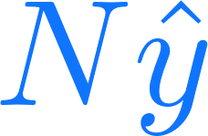


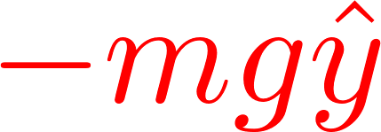



2nd Midterm
Q3. A simple pendulum of mass m₂, with a mass m₁ at the point of support which can only move horizontally on a frictionless track lying in the plane in which m₂ moves as shown in the figure below. The system is placed in a uniform gravitational field . The length of the rod is and its mass is negligible. The angle DOES NOT have to be small.
(c) Write down the equation of the rotational motion ( does not have to be small)
If you take (0,0) as where the rotational axis goes through, you need to calculate the torque due to N.
Take location of m₁ as where the rotational axis goes through.
(Correct angular momentum - 7 pts)
(2 pts)
(6 pts)

Slide 13









2nd Midterm
Q3. A simple pendulum of mass m₂, with a mass m₁ at the point of support which can only move horizontally on a frictionless track lying in the plane in which m₂ moves as shown in the figure below. The system is placed in a uniform gravitational field . The length of the rod is and its mass is negligible. The angle DOES NOT have to be small.
(d) Find its period for small oscillations.
(10 pts)

Slide 14
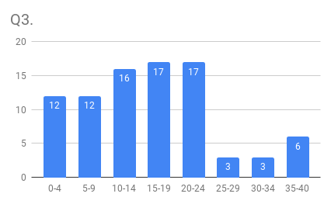
2nd Midterm

